Slide 1
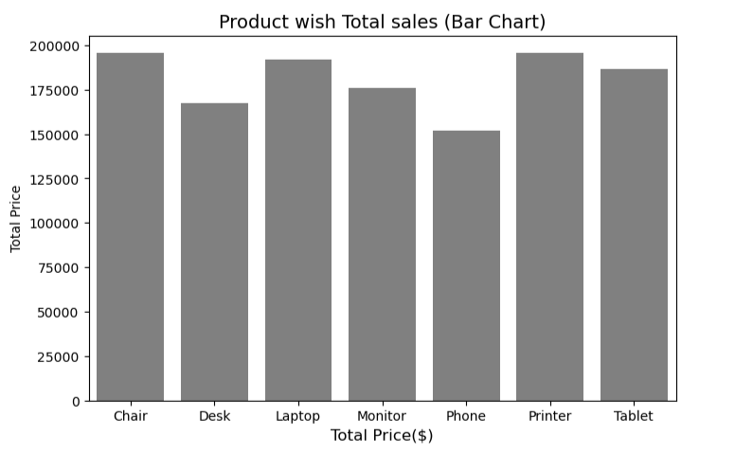
All Products Exceed $150k
For the upcoming year 2026, new marketing strategies are needed to increase
the sales of Phones and Desks. At the same time, the current market position
of Chairs, Printers, and Laptops should be maintained.
Sourece:sales perfomance report(2023-2025)

Slide 2
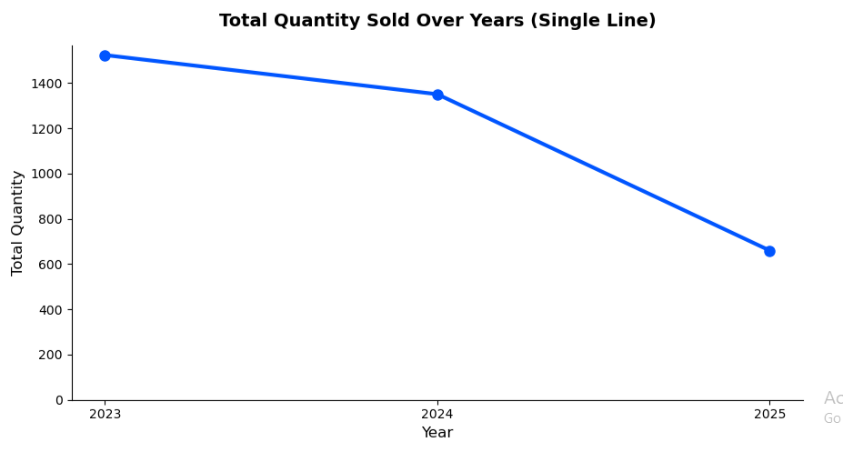
Marketing &Promotion
New customers should be attracted through Social Media Ads, Google Ads, and Influencer Marketing.
If your products are not yet being sold online (through Amazon or Flipkart), you should start online
sales immediately.
Sales should be expanded beyond the current markets by targeting new cities or new customer segments .

Slide 3
Digitize your sales and achieve success. Thank you, goodbye!

